Slide 1

Data Structures
Module Number: 5.1
Module Name: GRAPHS
Version: DSA3
Released Date : 24-SEP-2018

Slide 2
GRAPHS
AIM
To establish the knowledge on graph data structures and graph algorithms

Slide 3
GRAPHS
Objective of This Module
The Objectives of this module are:
o understand about graph data structure.
To get an idea about the application domain of graph theory.
To understand graph based algorithms to solve practical problem.
To develop and implement different graph algorithms.

Slide 4
GRAPHS
Outcome
At the end of this module, you are expected to:
Learn various graph algorithms.
Learn to apply graphs for solving practical problems.
Implement the graph theoretical concepts.

Slide 5
GRAPHS
Contents
Graphs
Graph Representation and Traversal Algorithms
Spanning Trees
Topological Sorting

Slide 6
GRAPHS
GRAPHS

Slide 7
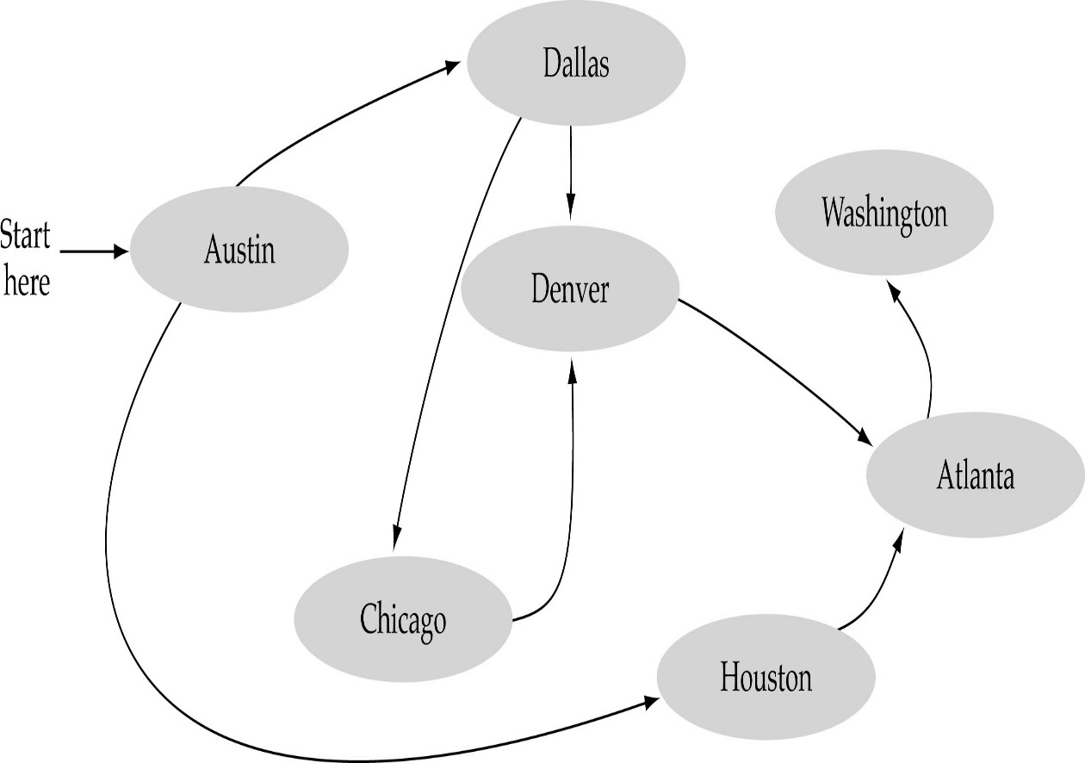
GRAPHS
What is a graph?
A data structure that consists of a set of nodes (vertices) and a set of edges that relate the nodes to each other
The set of edges describes relationships among the vertices

Slide 8
GRAPHS
Formal definition of graphs
A graph G is defined as follows:
G=(V,E)
V(G): a finite, nonempty set of vertices
E(G): a set of edges (pairs of vertices)

Slide 9
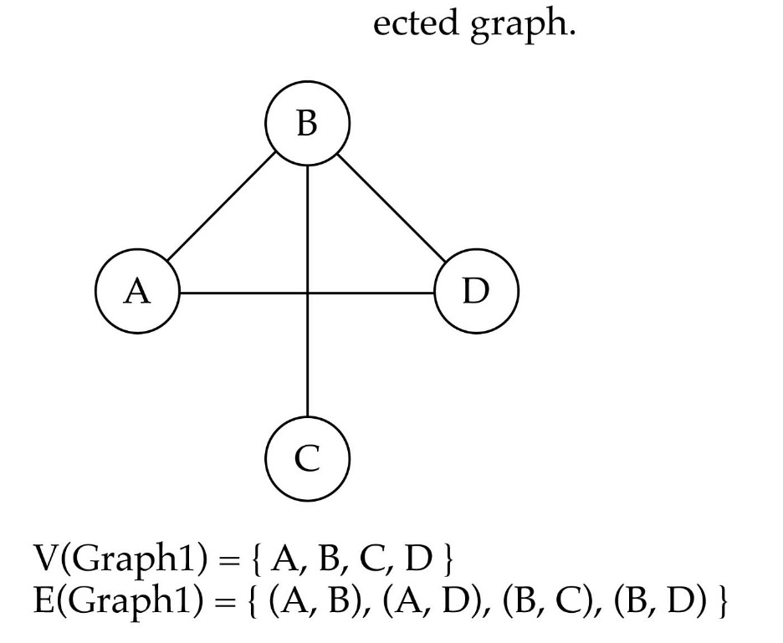
GRAPHS
Directed vs. undirected graphs
When the edges in a graph have no direction, the graph is called undirected.

Slide 10
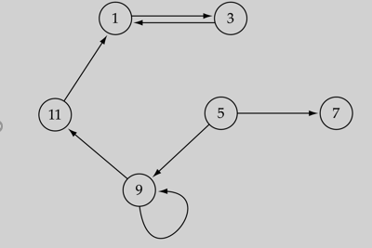
GRAPHS
Directed vs. undirected graphs (cont.)
When the edges in a graph have a direction, the graph is called directed (or digraph).

Slide 11

GRAPHS
Trees vs graphs
Trees are special cases of graphs!

Slide 12

GRAPHS
Graph terminology
Adjacent nodes: two nodes are adjacent if they are connected by an edge.
Path: a sequence of vertices that connect two nodes in a graph.
Complete graph: a graph in which every vertex is directly connected to every other vertex.

Slide 13
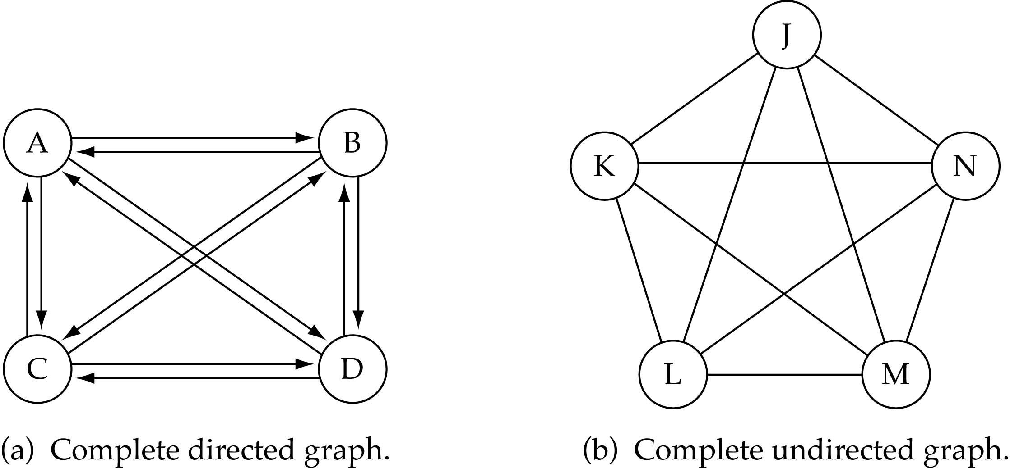
GRAPHS
What is the number of edges in a complete directed graph with N vertices?
N * (N-1)

Slide 14
GRAPHS
What is the number of edges in a complete undirected graph with N vertices?
N * (N-1) / 2

Slide 15
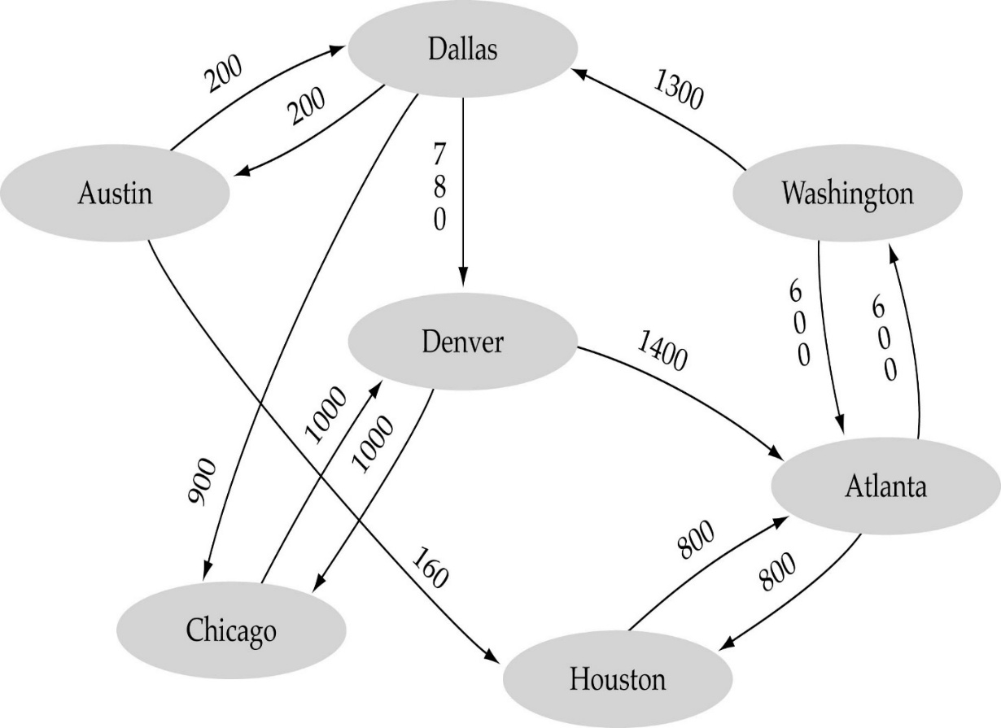
GRAPHS
Weighted graph: a graph in which each edge carries a value

Slide 16
GRAPHS
Self Assessment Questions
1. A graph is a non linear data structure. State whether true or false.
True
False
Answer: a)
Notes:
1. a)

Slide 17
GRAPHS
2. Which of the following statements for a simple graph is correct?
Every path is a trail
Every trail is a path
Every trail is a path as well as every path is a trail
None of the mentioned
Answer: a)
Notes:
2. a)

Slide 18
GRAPHS
3. What is the number of edges present in a complete graph having n vertices?
(n*(n+1))/2
(n*(n-1))/2
n
Information given is insufficient
Answer: b)
Notes:
3. b)

Slide 19
GRAPHS
Document Links
Topics | URL | Notes
General Trees | http://www.cs.cmu.edu/~clo/www/CMU/DataStructures/Lessons/lesson4_1.htm | Include notes on General trees

Slide 20
GRAPHS
Video Links
Topics | URL | Notes
Introduction to graphs | https://www.youtube.com/watch?v=gXgEDyodOJU | This video explains about tree basics of graph structure.

Slide 21
GRAPHS
GRAPHS REPRESENTATIONS AND TRAVERSAL ALGORITHMS

Slide 22
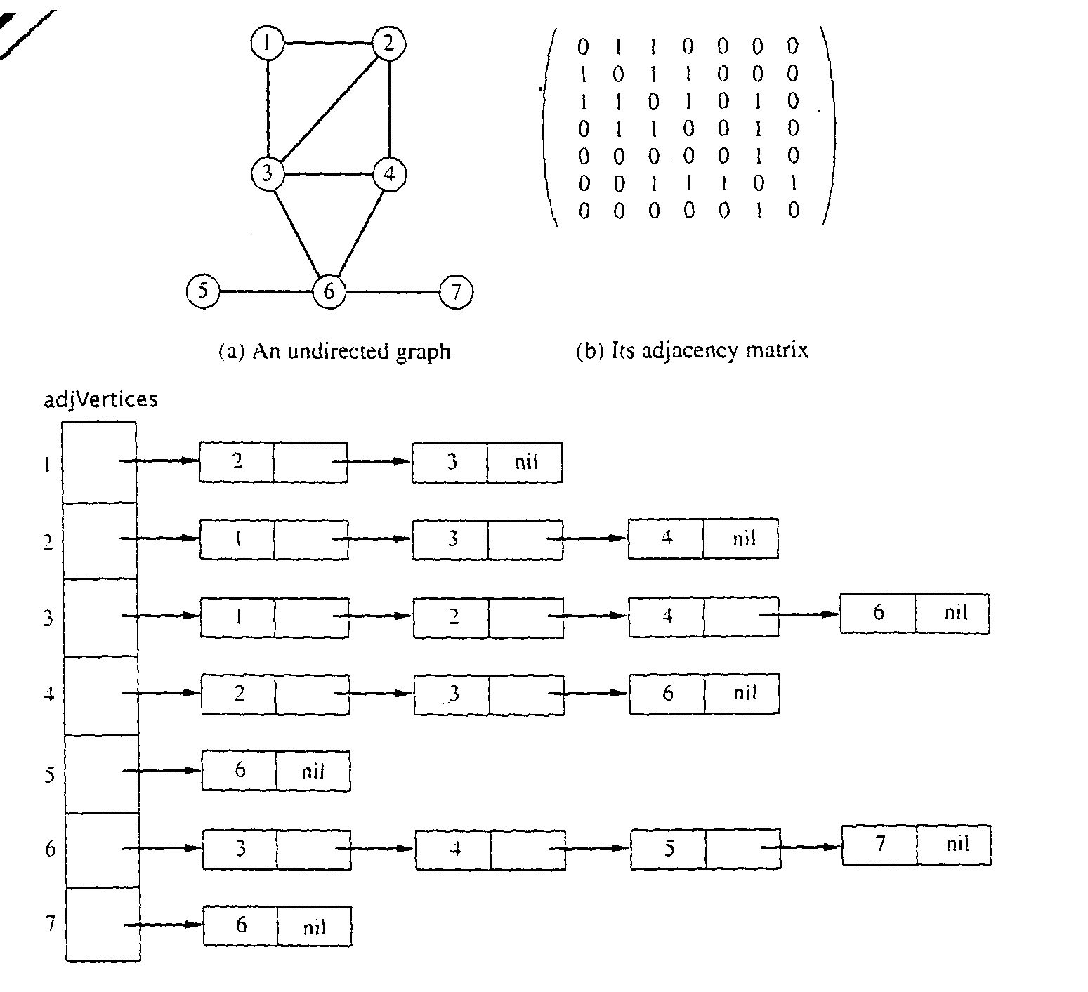
GRAPHS
Graph Representations using Data Structures
Adjacency Matrix Representation
Let G = (V,E), n = |V|, m = |E|, V = {v1, v2, …, vn)
G can be represented by an n  n matrix

Slide 23
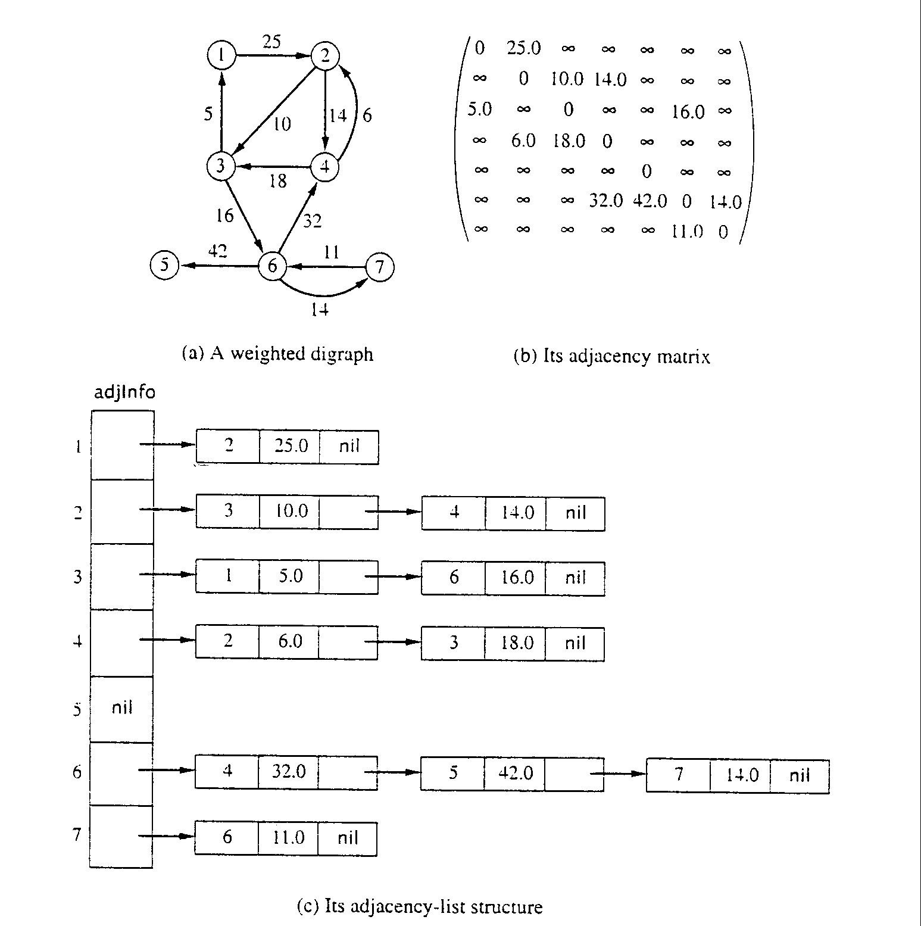
GRAPHS
Adjacency Matrix for weight digraph

Slide 24
GRAPHS
Array of Adjacency Lists Representation
From
to

Slide 25
GRAPHS
Array of Adjacency Lists Representation
from -> to, weight

Slide 26
GRAPHS
Graph Traversal Algorithms
To systematically visit the nodes of a graph
A tree is a directed, acyclic, graph (DAG)
If the graph is a tree,
DFS is exhibited by preorder, postorder, and (for binary trees) inorder traversals
BFS is exhibited by level-order traversal

Slide 27
GRAPHS
Depth-First Search
// recursive, preorder, depth-first search
void dfs (Node v) {
if (v == null)
return;
if (v not yet visited)
visit&mark(v); // visit node before adjacent nodes
for (each w adjacent to v)
if (w has not yet been visited)
dfs(w);
} // dfs

Slide 28
GRAPHS
// recursive, postorder, depth-first search
void dfs (Node v) {
if (v == null)
return;
tag(v); // mark v as having been considered
for (each w adjacent to v)
if (w has not yet been tagged)
dfs(w);
visit(v); // postorder traversal: visit node after
// adjacent nodes
} // dfs

Slide 29
GRAPHS
Example
5
2
0
1
3
7
4
6
Policy: Visit adjacent nodes in increasing index order

Slide 30
GRAPHS
Preorder DFS: Start with Node 5
5
2
0
1
3
7
4
6
5 1 0 3 2 7 6 4

Slide 31
GRAPHS
5
5
2
0
1
3
7
4
6
Push 5

Slide 32
GRAPHS
5
2
0
1
3
7
4
6
Pop/Visit/Mark 5
5

Slide 33
GRAPHS
1
2
5
2
0
1
3
7
4
6
Push 2, Push 1
5

Slide 34
GRAPHS
2
5
2
0
1
3
7
4
6
Pop/Visit/Mark 1
5 1

Slide 35
GRAPHS
5
2
0
0
2
4
2
1
3
7
4
6
Push 4, Push 2, Push 0
5 1

Slide 36
GRAPHS
5
2
2
4
2
0
1
3
7
4
6
Pop/Visit/Mark 0
5 1 0

Slide 37
GRAPHS
5
3
7
2
4
2
2
0
1
3
7
4
6
Push 7, Push 3
5 1 0

Slide 38
GRAPHS
5
2
7
2
4
2
0
1
3
7
4
6
Pop/Visit/Mark 3
5 1 0 3

Slide 39
GRAPHS
5
2
7
2
4
2
2
0
1
3
7
4
6
Push 2
5 1 0 3

Slide 40
GRAPHS
5
2
7
2
4
2
0
1
3
7
4
6
Pop/Mark/Visit 2
5 1 0 3 2

Slide 41
GRAPHS
5
2
2
4
2
0
1
3
7
4
6
Pop/Mark/Visit 7
5 1 0 3 2 7

Slide 42
GRAPHS
5
2
6
2
4
2
0
1
3
7
4
6
Push 6
5 1 0 3 2 7

Slide 43
GRAPHS
5
2
2
4
2
0
1
3
7
4
6
Pop/Mark/Visit 6
5 1 0 3 2 7 6

Slide 44
GRAPHS
4
2
5
2
0
1
3
7
4
6
Pop (don’t visit) 2
5 1 0 3 2 7 6

Slide 45
GRAPHS
2
5
2
0
1
3
7
4
6
Pop/Mark/Visit 4
5 1 0 3 2 7 6 4

Slide 46
GRAPHS
5
2
0
1
3
7
4
6
Pop (don’t visit) 2
5 1 0 3 2 7 6 4

Slide 47
GRAPHS
5
2
0
1
3
7
4
6
Done
5 1 0 3 2 7 6 4

Slide 48
GRAPHS
Preorder DFS: Start with Node 5 Note: edge (0,3) removed
5
2
0
1
3
7
4
6
5 1 0 7 6 2 4 3

Slide 49
GRAPHS
Breadth-First Search
// non-recursive, preorder, breadth-first search
void bfs (Node v) {
if (v == null)
return;
enqueue(v);
while (queue is not empty) {
dequeue(v);
if (v has not yet been visited)
mark&visit(v);
for (each w adjacent to v)
if (w has not yet been visited && has not been queued)
enqueue(w);
} // while
} // bfs

Slide 50
GRAPHS
BFS: Start with Node 5
5
2
0
1
3
7
4
6
5 1 2 0 4 3 7 6

Slide 51
GRAPHS
5
2
0
1
3
7
4
6
5

Slide 52
GRAPHS
BFS: Node one-away
5
2
0
1
3
7
4
6
5

Slide 53
GRAPHS
BFS: Visit 1 and 2
5
2
0
1
3
7
4
6
5 1 2

Slide 54
GRAPHS
BFS: Nodes two-away
5
2
0
1
3
7
4
6
5 1 2

Slide 55
GRAPHS
BFS: Visit 0 and 4
5
2
0
1
3
7
4
6
5 1 2 0 4

Slide 56
GRAPHS
BFS: Nodes three-away
5
2
0
1
3
7
4
6
5 1 2 0 4

Slide 57
GRAPHS
BFS: Visit nodes 3 and 7
5
2
0
1
3
7
4
6
5 1 2 0 4 3 7

Slide 58
GRAPHS
BFS: Node four-away
5
2
0
1
3
7
4
6
5 1 2 0 4 3 7

Slide 59
GRAPHS
BFS: Visit 6
5
2
0
1
3
7
4
6
5 1 2 0 4 3 7 6

Slide 60
GRAPHS
Self Assessment Questions
Which of the following algorithms can be used most efficiently to determine the presence of a cycle in a given graph ?
DFS
BFS
Prim’s Algorithm
Kruskal’s Algorithm
Answer: a)
Notes:
1. a)

Slide 61
GRAPHS
_________________ is used to implement BFS algorithm.
Stack
Queue
Tree
Array
Answer: b)
Notes:
2. b)

Slide 62
GRAPHS
3. Graphs are represented using ............
Adjacency tree
Adjacency linked list
Adjacency graph
Adjacency queue
Answer: b)
Notes:
3. b)

Slide 63
GRAPHS
Document Links
Topics | URL | Notes
Graph Representation | https://www.geeksforgeeks.org/graph-and-its-representations/ | Include notes on different types of graph representation.
Graph Traversal | http://btechsmartclass.com/DS/U3_T10.html | Include notes on BFS, DFS.

Slide 64
GRAPHS
Video Links
Topics | URL | Notes
Graph Representation | https://www.youtube.com/watch?v=1n5XPFcvxds | Include notes on different types of graph representation.
Graph Traversal | https://www.youtube.com/watch?v=bIA8HEEUxZI | Include notes on BFS, DFS.

Slide 65
GRAPHS
SPANNING TREES

Slide 66
GRAPHS
Spanning trees
Suppose you have a connected undirected graph
Connected: every node is reachable from every other node
Undirected: edges do not have an associated direction then a spanning tree of the graph is a connected subgraph in which there are no cycles
A connected, undirected graph
Four of the spanning trees of the graph

Slide 67
GRAPHS
Finding a spanning tree
To find a spanning tree of a graph, pick an initial node and call it part of the spanning tree
Do a search from the initial node: each time you find a node that is not in the spanning tree, add to the spanning tree both the new node and the edge you followed to get to it
An undirected graph
One possible result of a DFS starting from top
One possible result of a BFS starting from top

Slide 68
GRAPHS
Minimizing costs
Suppose you want to supply a set of houses (say, in a new subdivision) with:
electric power
water
sewage lines
telephone lines
To keep costs down, you could connect these houses with a spanning tree (for example, power lines)
However, the houses are not all equal distances apart
To reduce costs even further, you could connect the houses with a minimum-cost spanning tree

Slide 69
GRAPHS
Minimum-cost spanning trees
Suppose you have a connected undirected graph with a weight (or cost) associated with each edge
The cost of a spanning tree would be the sum of the costs of its edges
A minimum-cost spanning tree is a spanning tree that has the lowest cost
16
16
A
B
A
B
21
11
6
11
6
19
5
5
F
C
F
C
33
14
10
E
18
D
E
18
D
A connected, undirected graph
A minimum-cost spanning tree

Slide 70
GRAPHS
Finding spanning trees
There are two basic algorithms for finding minimum-cost spanning trees, and both are greedy algorithms.
Kruskal’s algorithm: Start with no nodes or edges in the spanning tree, and repeatedly add the cheapest edge that does not create a cycle.
Here, we consider the spanning tree to consist of edges only
Prim’s algorithm: Start with any one node in the spanning tree, and repeatedly add the cheapest edge, and the node it leads to, for which the node is not already in the spanning tree.
Here, we consider the spanning tree to consist of both nodes and edges

Slide 71
GRAPHS
Kruskal’s algorithm
T = empty spanning tree; E = set of edges; N = number of nodes in graph;
while T has fewer than N - 1 edges {
remove an edge (v, w) of lowest cost from E
if adding (v, w) to T would create a cycle
then discard (v, w)
else add (v, w) to T
}
Finding an edge of lowest cost can be done just by sorting the edges
Efficient testing for a cycle requires a fairly complex algorithm (UNION-FIND) which we don’t cover in this course

Slide 72
GRAPHS
Prim’s algorithm
T = a spanning tree containing a single node s; E = set of edges adjacent to s; while T does not contain all the nodes {
remove an edge (v, w) of lowest cost from E
if w is already in T then discard edge (v, w)
else {
add edge (v, w) and node w to T
add to E the edges adjacent to w
}
}
An edge of lowest cost can be found with a priority queue
Testing for a cycle is automatic
Hence, Prim’s algorithm is far simpler to implement than Kruskal’s algorithm

Slide 73
GRAPHS
Self Assessment Questions
Which of the following is/are the operations performed by kruskal’s algorithm?
i) sort the edges of G in increasing order by length ii) keep a subgraph S of G initially empty iii) builds a tree one vertex at a time
i, and ii only
ii and iii only
i and iii only
All i, ii and iii
Answer: a)
Notes:
4. a)

Slide 74
GRAPHS
Rather than build a subgraph one edge at a time …………………………. builds a tree one vertex at a time.
kruskal’s algorithm
prim’s algorithm
dijkstra algorithm
bellman ford algorithm
Answer: b)
Notes:
5. b)

Slide 75
GRAPHS
6. A Graph may have more than one MST. State whether true or false.
True
False
Answer: a)
Notes:
6. a)

Slide 76
GRAPHS
Document Links
Topics | URL | Notes
Spanning Trees | https://www.tutorialspoint.com/data_structures_algorithms/spanning_tree.htm | Include notes on Spanning trees, minimum cost spanning tree, and spanning tree algorithms

Slide 77
GRAPHS
Video Links
Topics | URL | Notes
Spanning Trees | https://www.youtube.com/watch?v=k9jemw3SZe0 | Include notes on Spanning trees, minimum cost spanning tree, and spanning tree algorithms

Slide 78
GRAPHS
TOPOLOGICAL SORT

Slide 79
GRAPHS
Topological Sort
Sorting technique over DAGs (Directed Acyclic Graphs)
It creates a linear sequence (ordering) for the nodes such that:
If u has an outgoing edge to v ➔ then u must finish before v starts
Very common in ordering jobs or tasks

Slide 80
GRAPHS
Topological Sort Example
Make a directed graph and then do DFS.
A job consists of 10 tasks with the following precedence rules:
Must start with 7, 5, 4 or 9.
Task 1 must follow 7.
Tasks 3 & 6 must follow both 7 & 5.
8 must follow 6 & 4.
2 must follow 4.
10 must follow 2.

Slide 81
GRAPHS
Tasks shown as a directed graph.
9
1
10
7
3
8
5
6
4
2

Slide 82
GRAPHS
Topological Sort using DFS
To create a topological sort from a DAG
1- Final linked list is empty
2- Run DFS
3- When a node becomes black (finishes) insert it to the top of a linked list

Slide 83
GRAPHS
Example
9
1
7
3
8
5
6
4
10
2

Slide 84
GRAPHS
9
1
7
3
8
5
6
10
4
2

Slide 85
GRAPHS
9
1
7
3
8
5
6
10
2
4

Slide 86
GRAPHS
9
1
7
3
8
5
6
4
10
2

Slide 87
GRAPHS
9
1
head
10
7
3
8
5
6
4
10
2

Slide 88
GRAPHS
9
1
head
2, 10
7
3
8
5
6
4
10
2

Slide 89
GRAPHS
9
1
head
2, 10
7
3
8
5
6
4
10
2

Slide 90
GRAPHS
9
1
head
8, 2, 10
7
3
8
5
6
4
10
2

Slide 91
GRAPHS
9
1
head
4, 8, 2, 10
7
3
8
5
6
4
10
2

Slide 92
GRAPHS
9
1
head
4, 8, 2, 10
7
3
8
5
6
4
10
2

Slide 93
GRAPHS
9
1
7
head
4, 8, 2, 10
3
8
5
6
4
10
2

Slide 94
GRAPHS
9
1
7
1, 4, 8, 2, 10
3
head
8
5
6
4
10
2

Slide 95
GRAPHS
9
1
7
3
1, 4, 8, 2, 10
head
8
5
6
4
10
2

Slide 96
GRAPHS
9
1
7
head
3, 1, 4, 8, 2, 10
3
8
5
6
4
10
2

Slide 97
GRAPHS
9
1
7
3, 1, 4, 8, 2, 10
3
head
8
5
6
4
10
2

Slide 98
GRAPHS
9
1
7
3
head
6, 3, 1, 4, 8, 2, 10
8
5
6
4
10
2

Slide 99
GRAPHS
9
1
7
7, 6, 3, 1, 4, 8, 2, 10
3
head
8
5
6
4
10
2

Slide 100
GRAPHS
9
1
7
7, 6, 3, 1, 4, 8, 2, 10
3
head
8
5
6
4
10
2

Slide 101
GRAPHS
9
1
7
9, 7, 6, 3, 1, 4, 8, 2, 10
3
head
8
5
6
4
10
2

Slide 102
GRAPHS
9
1
head
9, 7, 6, 3, 1, 4, 8, 2, 10
7
3
8
5
6
4
10
2

Slide 103
GRAPHS
9
1
7
head
5, 9, 7, 6, 3, 1, 4, 8, 2, 10
3
8
5
6
4
10
2

Slide 104
GRAPHS
Topological Sort: Summary
9
head
1
5, 9, 7, 6, 3, 1, 4, 8, 2, 10
7
3
The final order or jobs
8
5
6
Time complexity = DFS complexity O(V + E)
4
There can be many orders that meet the requirements
10
2

Slide 105
GRAPHS
Self Assessment Questions
7. Topological sort can be applied to which of the following graphs?
Undirected Cyclic Graphs
Directed Cyclic Graphs
Undirected Acyclic Graphs
Directed Acyclic Graphs
Answer: d)
Notes:
7. d)

Slide 106
GRAPHS
8. Topological sort starts from a node which has?
Maximum Degree
Minimum Degree
Any degree
None of the mentioned
Answer: b)
Notes:
8. b)

Slide 107
GRAPHS
Assignment
Count all possible paths between two vertices
Count the total number of ways or paths that exist between two vertices in a directed graph. These paths doesn’t contain a cycle, the simple enough reason is that a cycle contain infinite number of paths and hence they create problem.
Longest Path in a Directed Acyclic Graph
Given a Weighted Directed Acyclic Graph (DAG) and a source vertex s in it, find the longest distances from s to all other vertices in the given graph.

Slide 108
GRAPHS
Document Links
Topics | URL | Notes
Topological Sort | https://www.geeksforgeeks.org/topological-sorting/ | Include notes on topological sorting

Slide 109
GRAPHS
Video Links
Topics | URL | Notes
Topological Sort | https://www.youtube.com/watch?v=Q9PIxaNGnig | Include notes on topological sorting

Slide 110
GRAPHS
E-Book Links
Topics | URL | Notes
Data Structures and Algorithms | http://lib.mdp.ac.id/ebook/Karya%20Umum/Dsa.pdf | It contains all the desired Information's about graph.

